Slide 1
Combinational Logic Circuit
Part-1

Slide 2
Design Procedure
Specification -
Writing a specification for the circuit if one is not already available.
Formulation-
Derive a truth table or initial Boolean equations that define the required relationships between the inputs and outputs
Optimization-
Apply 2-level and multiple-level optimization,
Technology Mapping-
Map the logic diagram or netlist using the available implementation technology
Verification-
Verify the correctness of the final circuit.

Slide 3
Combinational Circuits
A combinational logic circuit has:
A set of m Boolean inputs,
A set of n Boolean outputs, and
n switching functions, each mapping the 2^{m} input combinations to an output such that the current output depends only on the current input values
A block diagram:
Combinatorial
Logic
Circuit
m Boolean Inputs
n Boolean Outputs

Slide 4
Example: BCD to Excess-3 code converter
Specification:
Excess-3 code for a decimal digit is the binary combination corresponding to the decimal digit plus 3.
Transforms BCD code for the decimal digits to Excess-3 code for the decimal digits
BCD code words for digits 0 through 9: 4-bit patterns 0000 to 1001, respectively
Excess-3 code words for digits 0 through 9: 4-bit patterns consisting of 3 (binary 0011) added to each BCD code word

Slide 5
2. Formulation
Conversion of 4-bit codes can be most easily formulated by a truth table
Variables - BCD: A,B,C,D
Variables - Excess-3 W,X,Y,Z
Don’t Cares - BCD 1010 to 1111
Decimal | Input BCD A B C D | Output Excess-3 WXYZ
0 | 0 0 0 0 | 0 0 1 1
1 | 0 0 0 1 | 0 1 0 0
2 | 0 0 1 0 | 0 1 0 1
3 | 0 0 1 1 | 0 1 1 0
4 | 0 1 0 0 | 0 1 1 1
5 | 0 1 0 1 | 1 0 0 0
6 | 0 1 1 0 | 1 0 0 1
7 | 0 1 1 1 | 1 0 1 0
8 | 1 0 0 0 | 1 0 1 1
9 | 1 0 0 1 | 1 1 0 0

Slide 6


optimization
w
Decimal | Input BCD A B C D | Output Excess-3 WXYZ
0 | 0 0 0 0 | 0 0 1 1
1 | 0 0 0 1 | 0 1 0 0
2 | 0 0 1 0 | 0 1 0 1
3 | 0 0 1 1 | 0 1 1 0
4 | 0 1 0 0 | 0 1 1 1
5 | 0 1 0 1 | 1 0 0 0
6 | 0 1 1 0 | 1 0 0 1
7 | 0 1 1 1 | 1 0 1 0
8 | 1 0 0 0 | 1 0 1 1
9 | 1 0 0 1 | 1 1 0 0
x
CD
CD
CD
CD
CD
CD
CD
CD
00
01
11
10
00
01
11
10
AB
00
AB
00
1
1
1
0
1
3
2
0
1
3
2
AB
01
1
1
1
AB
01
1
4
5
7
6
4
5
7
6
AB
11
X
X
X
X
AB
11
X
X
X
X
12
13
15
14
12
13
15
14
AB
10
1
1
X
X
AB
10
1
X
X
8
9
11
10
8
9
11
10
$$W=A+BC+BD$$
$$X=\overline{B}D+\overline{B}C+B\overline{C}\overline{D}$$

Slide 7


Optimization
Decimal | Input BCD A B C D | Output Excess-3 WXYZ
0 | 0 0 0 0 | 0 0 1 1
1 | 0 0 0 1 | 0 1 0 0
2 | 0 0 1 0 | 0 1 0 1
3 | 0 0 1 1 | 0 1 1 0
4 | 0 1 0 0 | 0 1 1 1
5 | 0 1 0 1 | 1 0 0 0
6 | 0 1 1 0 | 1 0 0 1
7 | 0 1 1 1 | 1 0 1 0
8 | 1 0 0 0 | 1 0 1 1
9 | 1 0 0 1 | 1 1 0 0
y
z
CD
CD
CD
CD
CD
CD
CD
CD
00
01
11
10
00
01
11
10
AB
00
1
1
AB
00
1
1
0
1
3
2
1
3
2
AB
01
1
1
AB
01
1
1
4
5
7
6
4
5
7
6
AB
11
X
X
X
X
AB
11
X
X
X
X
12
13
15
14
12
13
15
14
AB
10
1
X
X
AB
10
1
X
X
8
9
11
10
8
9
11
10
$$Y=\overline{C}\overline{D}+CD$$
$$Z=\overline{D}$$

Slide 8










Optimization (continued)
Multiple-level using transformations
$$W=A+BC+BD$$
$$X=\overline{B}D+\overline{B}C+B\overline{C}\overline{D}$$
G = 6 + 10 + 6 + 1 = 23
$$Y=\overline{C}\overline{D}+CD$$
$$Z=\overline{D}$$
Perform extraction, finding factor:
$$T_{1}=C+D$$
$$W=A+BT_{1}$$
$$X=\overline{B}T_{1}+B\overline{T_{1}}$$
[$\overline{C}\overline{D}=\overline{C+D}=\overline{T_{1}}]$
$$Y=CD+\overline{T_{1}}$$
$$Z=\overline{D}$$
G = 2 + 4 + 6 + 5 + 1 = 18!

Slide 9
Design Example (continued)
Technology Mapping
Mapping with a library containing inverters and 2-input AND, 2-input OR,
A
W
B
X
C
Y
D
Z

Slide 10
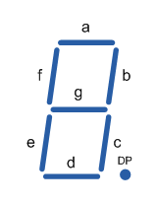
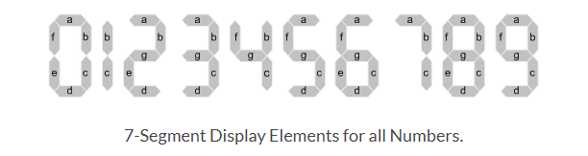
Example : BCD to Seven Segment decoder
Specification :
A BCD to seven segment decoder is a combinational circuit that accepts a decimal digit in BCD and generates the appropriate outputs for the segments of the display for that decimal digit.
The seven outputs of the decoder (a,b,c,d,e,f,g) select the corresponding segments in the display.
It has four inputs and seven outputs.

Slide 11
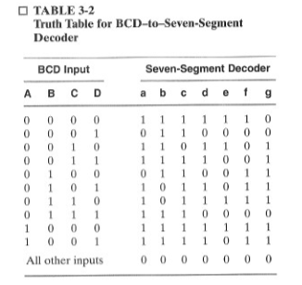
Formulation

Slide 12



Optimization
$$a=\overline{A}C+\overline{A}BD+\overline{B}\overline{C}\overline{D}+A\overline{B}\overline{C}$$
Gates : 27 AND gates and 7 OR gates
Can be reduced by sharing the product terms common to the different out expressions.
$$b=\overline{A}\overline{B}+\overline{A}CD+\overline{A}\overline{C}\overline{D}+A\overline{B}\overline{C}$$
$$c=\overline{A}B+\overline{A}D+\overline{B}\overline{C}\overline{D}+A\overline{B}\overline{C}$$
$$d=\overline{A}C\overline{D}+\overline{A}\overline{B}C+\overline{B}\overline{C}\overline{D}+A\overline{B}\overline{C}+\overline{A}B\overline{C}D$$
$$e=\overline{A}C\overline{D}+\overline{B}\overline{C}\overline{D}$$
$$f=\overline{A}B\overline{C}+\overline{A}\overline{C}\overline{D}+\overline{A}B\overline{D}+A\overline{B}\overline{C}$$
$$g=\overline{A}C\overline{D}+\overline{A}\overline{B}C+\overline{A}B\overline{C}+A\overline{B}\overline{C}$$

Slide 13
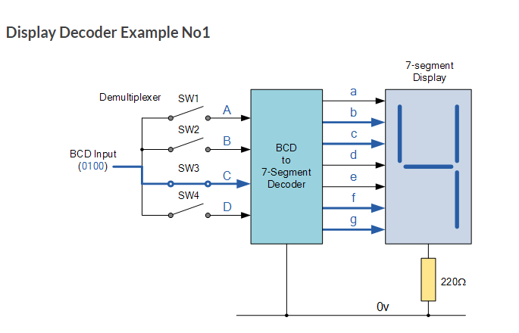
Display of Decoder
D
C
B
A

Slide 14
Beginning Hierarchical Design
To control the complexity of the function mapping inputs to outputs:
Decompose the function into smaller pieces called blocks
Decompose each block’s function into smaller blocks, repeating as necessary until all blocks are small enough
Any block not decomposed is called a primitive block
The collection of all blocks including the decomposed ones is a hierarchy

Slide 15
Example : Design of a 4 bit Equality comparator
Specification : An equality comparator is a circuit that compares two binary vectors to determine whether they are equal or not.
Inputs : 2 vectors A(3:0) and B(3:0). A consists of 4 bits A(3)-most significant bit. B same.
Output : Single bit E defining either equal or not.

Slide 16



Formulation
Bypass the use of truth table due to the size.( total 8 inputs 2^8 combinations)
For two vectors to be equal , the bit values in each of the respective positions must be equal.
A and B contain equal values in every position, then E=1 , otherwise E=0
The circuit can be developed as a simple 2-level hierarchy with the complete circuit at the top level and five circuits at the bottom level.
$A=\left[\begin{matrix}1 \\ 0 \\ \begin{aligned}1 \\ 0\end{aligned}\end{matrix}\right]$,
$$B=\left[\begin{matrix}1 \\ 0 \\ \begin{aligned}1 \\ 0\end{aligned}\end{matrix}\right]$$
𝐴=𝐵
$$E_{i}=\overline{A_{i}}B_{i}+A_{i}\overline{B_{i}}$$

Slide 17
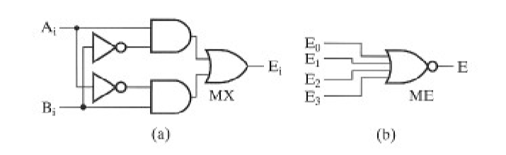
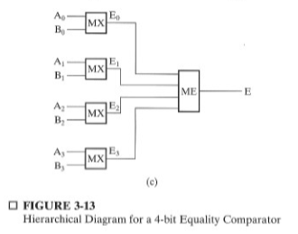
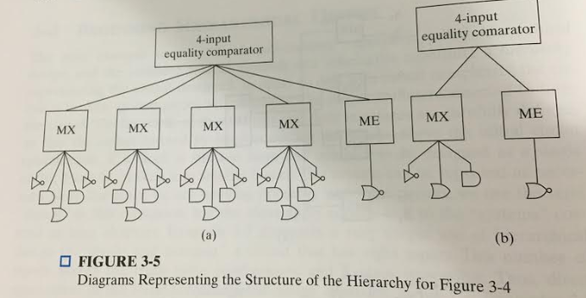
Optimization
Hierarchy reduce the complexity required to represent the schematic diagram.
In hierarchy model , complex structures have symbols instead of logic schematics. Their functions can be defined by a program description. Example MX
Reusable blocks.

Slide 18
Reusable Functions
Whenever possible, we try to decompose a complex design into common, reusable function blocks
These blocks are
verified and well-documented
placed in libraries for future use

Slide 19
Technology Mapping
Mapping Procedures
To NAND gates
To NOR gates
Mapping to multiple types of logic blocks is covered in the reading supplement: Advanced Technology Mapping (book).

Slide 20
Mapping to NAND gates
Assumptions:
Gate loading and delay are ignored
Cell library contains an inverter and n-input NAND gates, n = 2, 3, …
An AND, OR, inverter schematic for the circuit is available
The mapping is accomplished by:
Replacing AND and OR symbols,
Push all inverters lying between (i) either a circuit input or a driving NAND gate output. and
Canceling inverter pairs

Slide 21
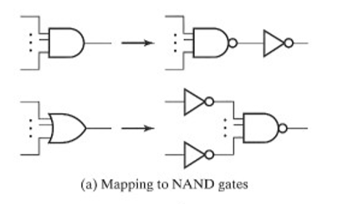
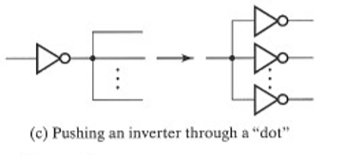

NAND Mapping Algorithm
1. Replace ANDs and ORs:
2. Pushing inverters
3. Canceling inverter pairs

Slide 22
NAND Mapping Example

Slide 23
Mapping to NOR gates
Assumptions:
Gate loading and delay are ignored
Cell library contains an inverter and n-input NOR gates, n = 2, 3, …
An AND, OR, inverter schematic for the circuit is available
The mapping is accomplished by:
Replacing AND and OR symbols,
Push all inverters lying between (i) either a circuit input or a driving NOR gate output. and
Canceling inverter pairs

Slide 24
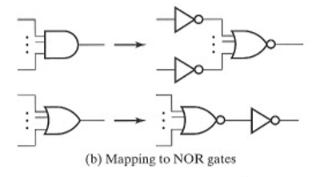
NOR Mapping Algorithm
2. Pushing inverters
1. Replace ANDs and ORs:
3. Canceling inverter pairs

Slide 25
NOR Mapping Example
A
A
B
B
X
C
F
C
F
D
D
E
(a)
A
E
(b)
B
C
F
D
E
(c)

Slide 26
Basic Verification Methods
Verification - show that the final circuit designed implements the original specification
Manual Logic Analysis
Find the truth table or Boolean equations for the final circuit
Compare the final circuit truth table with the specified truth table, or
Show that the Boolean equations for the final circuit are equal to the specified Boolean equations
Simulation
Simulate the final circuit (or its netlist, possibly written as an HDL) and the specified truth table, equations, or HDL description using test input values that fully validate correctness.
The obvious test for a combinational circuit is application of all possible “care” input combinations from the specification

Slide 27
Verification Example: Manual Analysis
BCD-to-Excess 3 Code Converter
Find the SOP Boolean equations from the final circuit.
Find the truth table from these equations
Compare to the formulation truth table
Finding the Boolean Equations:
$$T_{1}=C+D$$
$$W=A+BC+BD$$
$$W=A+BT_{1}$$
$$X=\overline{B}D+\overline{B}C+B\overline{C}\overline{D}$$
$$X=\overline{B}T_{1}+B\overline{T_{1}}$$
$$Y=\overline{C}\overline{D}+CD$$
$$Z=\overline{D}$$
$$Y=CD+\overline{T_{1}}$$
$$Z=\overline{D}$$

Slide 28

Verification Example: Manual Analysis
$$W=A+BC+BD$$
A | B | C | D | BC | BD | A+BC+BD | W
0 | 0 | 0 | 0 | 0 | 0 | 0 | 0
0 | 0 | 0 | 1 | 0 | 0 | 0 | 0
0 | 0 | 1 | 0 | 0 | 0 | 0 | 0
0 | 0 | 1 | 1 | 0 | 0 | 0 | 0
0 | 1 | 0 | 0 | 0 | 0 | 0 | 0
0 | 1 | 0 | 1 | 0 | 1 | 1 | 1
0 | 1 | 1 | 0 | 1 | 0 | 1 | 1
0 | 1 | 1 | 1 | 1 | 1 | 1 | 1
1 | 0 | 0 | 0 | 0 | 0 | 1 | 1
1 | 0 | 0 | 1 | 0 | 0 | 1 | 1
Input BCD
Output Excess 3
A B C D
WXYZ
0 0 0 0
0 0 1 1
0 0 0 1
0 1 0 0
0 0 1 0
0 1 0 1
0 0 1 1
0 1 1 0
0 1 0 0
0 1 1 1
0 1 0 1
1 0 0 0
0 1 1 0
1 0 0 1
0 1 1 1
1 0 1 0
1 0 0 0
1 0 1 1
1 0 0 1
1 0 1 1

Slide 29
Verification Example: Simulation
Simulation procedure:
Use a schematic editor or text editor to enter a gate level representation of the final circuit
Use a waveform editor or text editor to enter a test consisting of a sequence of input combinations to be applied to the circuit
This test should guarantee the correctness of the circuit if the simulated responses to it are correct

Slide 30
Verification Example: Simulation
Enter BCD-to-Excess-3 Code Converter Circuit Schematic

Slide 31
Enter waveform that applies all possible input combinations:
Enter waveform that applies all possible input combinations:
Are all BCD input combinations present? (Low is a 0 and high is a one)

Slide 32
Verification Example: Simulation
Run the simulation of the circuit for 120 ns
Do the simulation output combinations match the original truth table?

